Slide 1
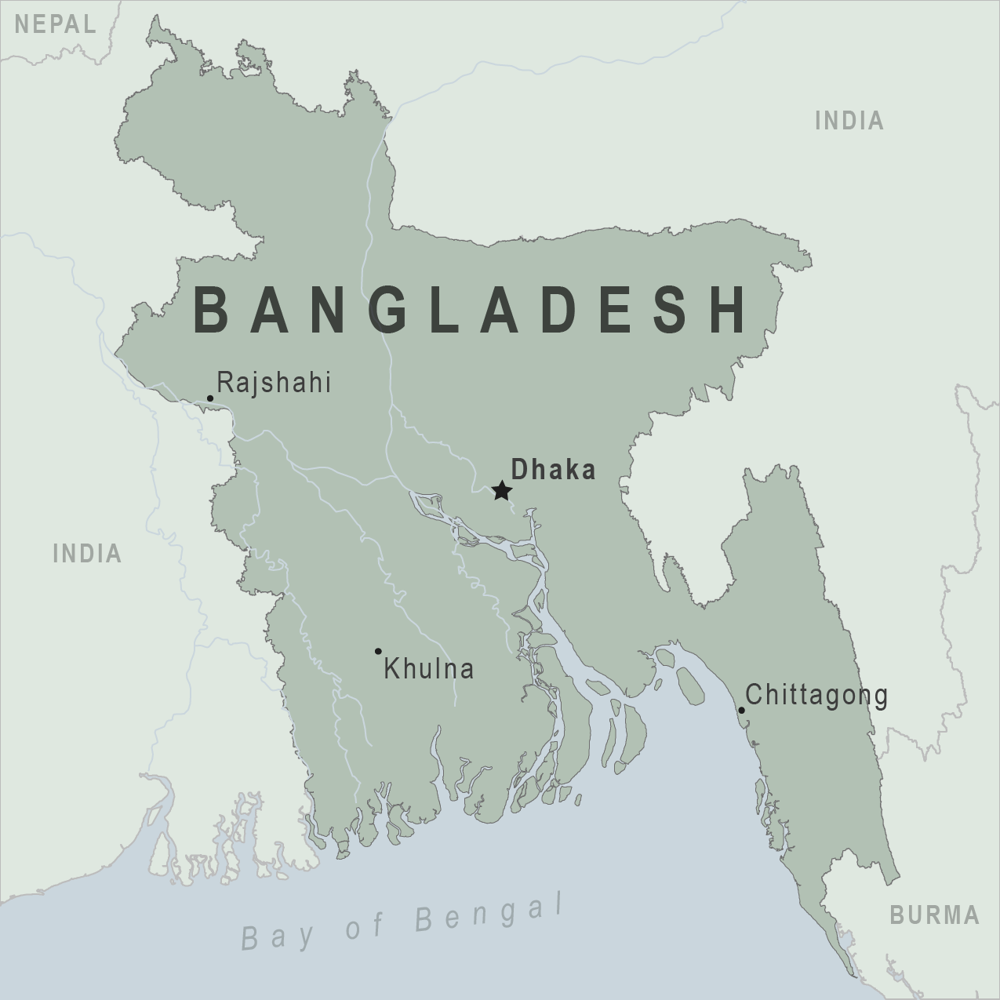
Eye Institute & Hospital Bangladesh
DhimaN Sarkar

Slide 2

Introduction
Founded 1960 in Bangladesh
“Not for Profit” hospital
Provide quality eye care for all walks of life
Team of over 1200 people and 300 full-time doctors
Notes:
Ispahani Islamia Eye Institute & Hospital (IIEI&H) is a legendary Institute in Bangladesh. The great philanthropist M A Ispahani founded this in 1960. A ‘Not for Profit’ Hospital was born with a mandate not only to provide quality eye-care for all segments of society but also to train doctors, surgeons and paramedics to serve the country. Today, it has a team of over 1200 people with 300 full-time doctors to serve in excess of a million patients annually through its own hospital network.

Slide 3
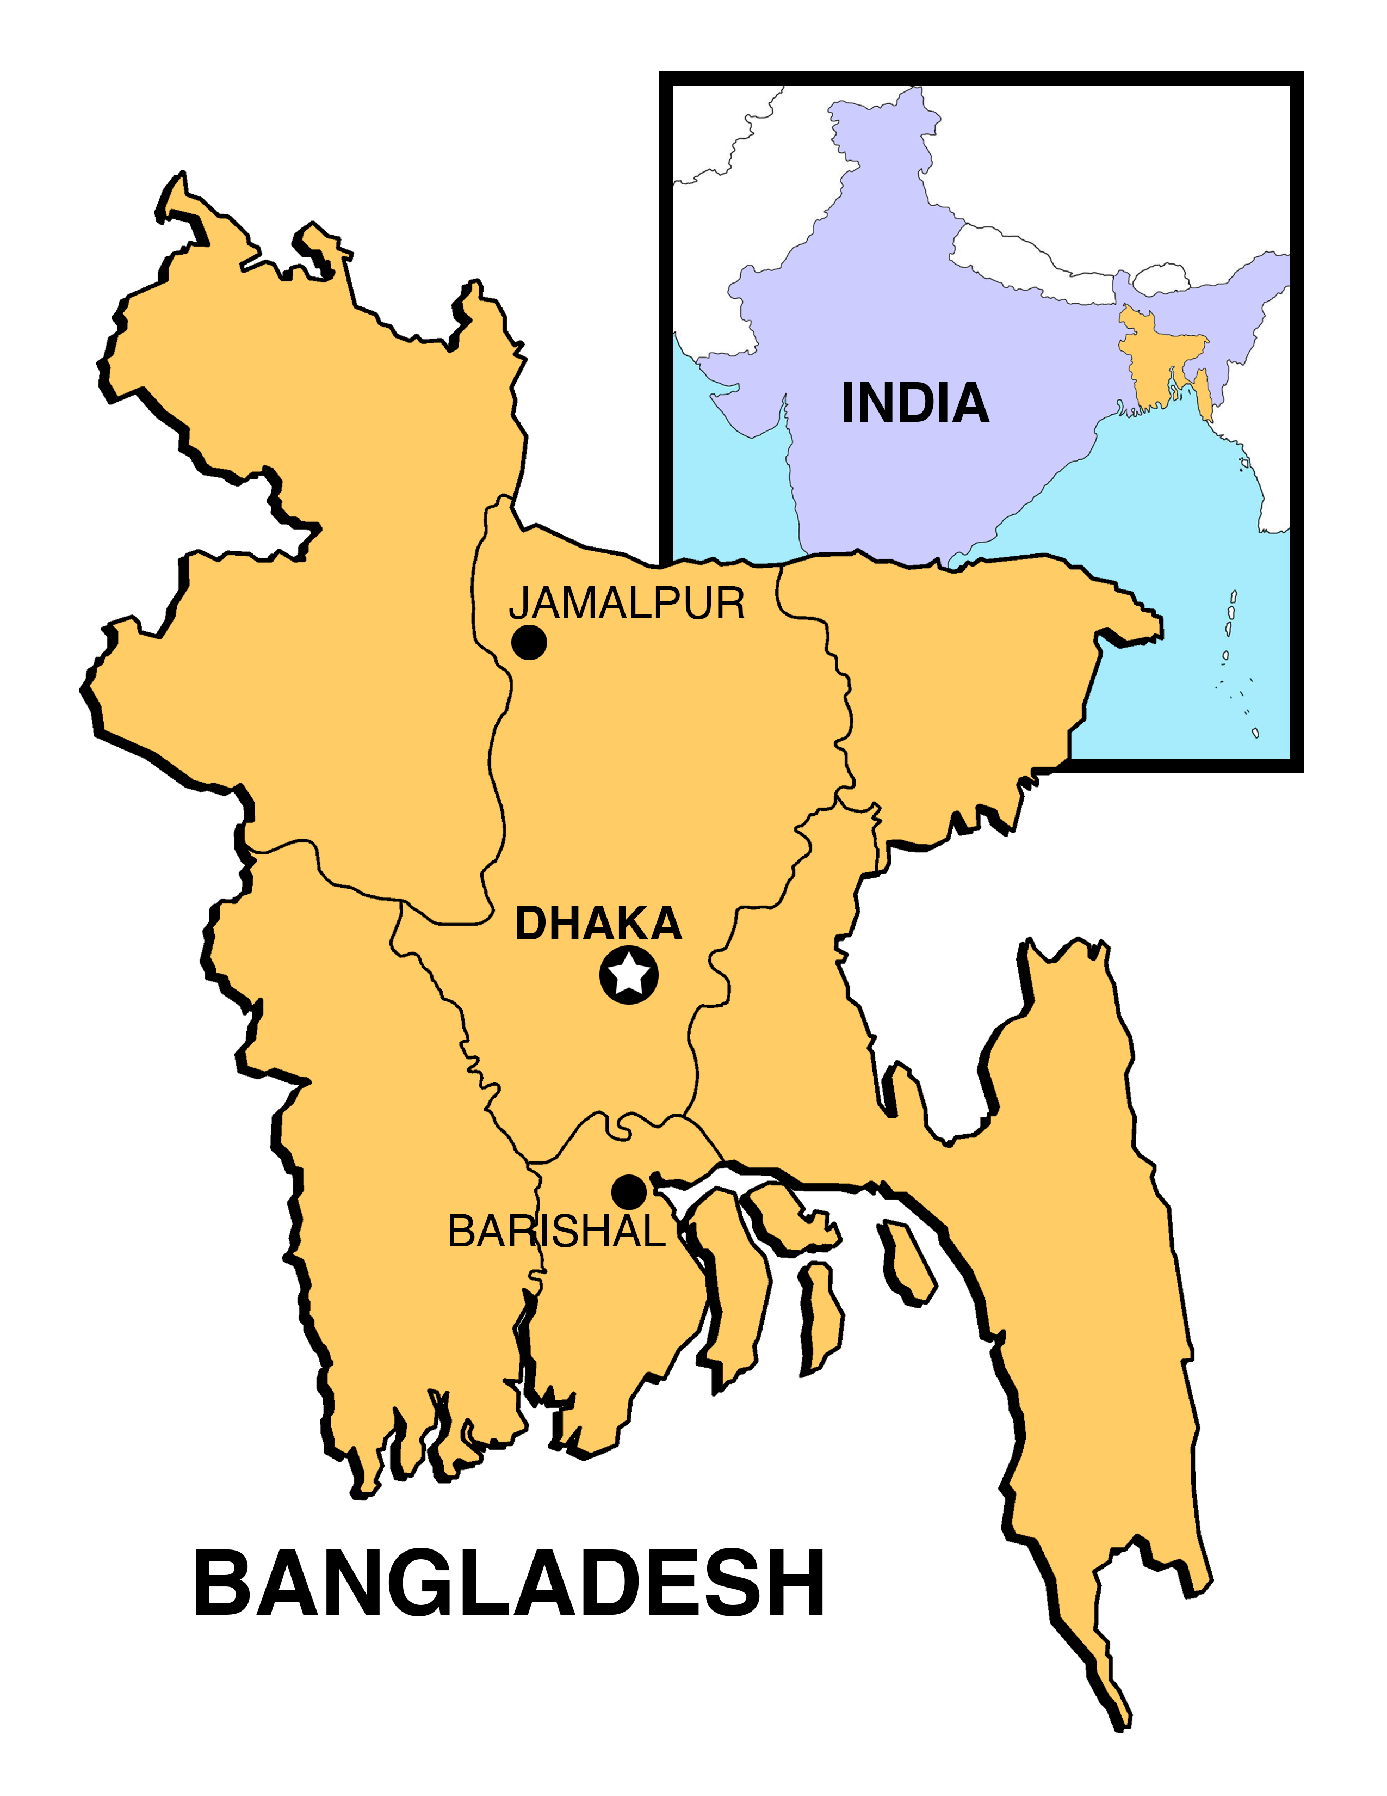

Slide 4
Goal & Purpose
Understand the phenomenon of cataracts in Bangladeshi children
Introduce a plan to reduce the cases in Bangladesh
Notes:
Childhood blindness affects an estimated 40,000 children in Bangladesh. According to a large study, 36 percent of these cases (primarily cataracts) are treatable and 32 percent preventable. The major causes of blindness in children encompass infectious diseases, genetics, nutritional factors, and birth defects.
We want to understand the phenomenon of cataracts in Bangladeshi children, as this disease usually affects older individuals. We were curious whether this is due to genetic, a specific area, or income level. More importantly, we would like to introduce a plan to reduce the cases in Bangladesh after learning more about this disease in children.

Slide 5
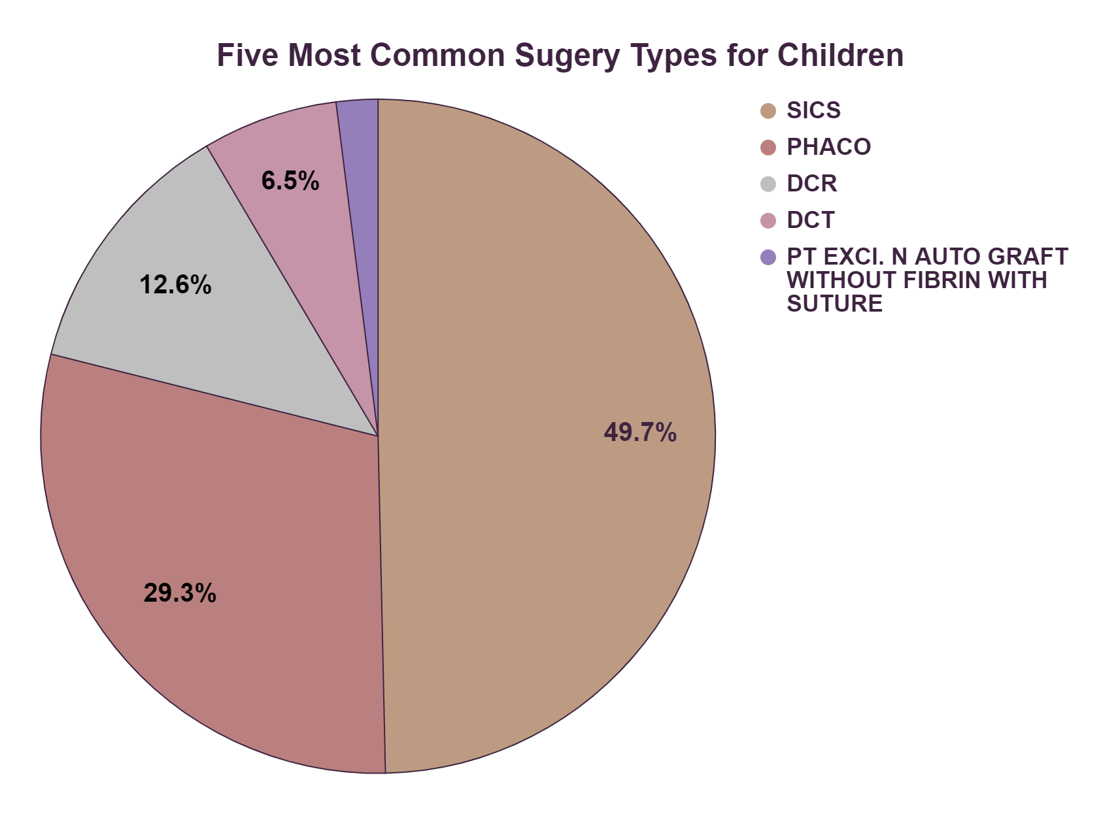
Cataracts make up 80% of the surgeries
Notes:
The reason why cataracts in children is such an urgent topic can be demonstrated in this graph. It shows the five most common surgery types in the Children age category. Of the top five most common surgeries, SICS and PHACO, which are both types of cataract surgeries, makeup approximately 79% of surgeries.

Slide 6
Preliminary questions
Why do children get cataracts?
Where does this phenomenon occur?
What is the demographic of these children?
What is the operation of cataracts like in the hospital?
Notes:
Our questions revolve around our need to understand cataracts in children. We ask from broad questions to more specific ones, like:
Why do children get cataracts?
Is this a regional phenomenon?
What is the demographic of these children?
What is the operation of cataracts like in the hospital?
These questions allow us to dive into the health status of Bangladeshi children. Once we understand the background of the situation, we can

Slide 7

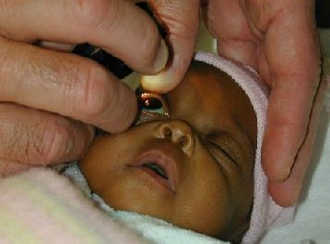
Dataset
Surgical data of the Ispahani Islamia Eye Institute and Hospital
Includes:
Patient demographics
Category of intake
Surgical duration
etc.
Study Bangladeshi at a large scale
Notes:
The dataset used for this study is a primary dataset retrieved from the IIEI&H servers containing 9981 rows and 16 columns of data across three different branches and hospital locations. We reached out to the Director of Information Technology and requested for the surgical data ranging from the year 2014 to 2020.
It is a record of the Ispahani Islamia Eye Institute and Hospital's surgical data indicating patient demographics, their unique medical record number, Category of intake, visitation date as per chronology, surgery duration along with the type and the cost of the respective surgery.

Slide 8



Methodology: Data Ingestion & Cleaning
Notes:
After requesting for the primary data, we converted our excel spreadsheet into a CSV file. We then uploaded this csv file into python and imported the necessary packages (pandas, numpy,
matplotlib). Next, it was ensured that we accounted for all the null and duplicate data and refined our dataset. We also identified some of our outliers that would skew our results and corrected them.

Slide 9
Methodology: Data Preparation
Column names
String formatting
Spelling errors
New columns added
Notes:
Since most of the column names were difficult for code referencing, it was changed to easier ones. Some of the data elements in the columns were in all upper case so it was changed to the string format. Some of the spelling errors were also corrected and new columns were added.

Slide 10
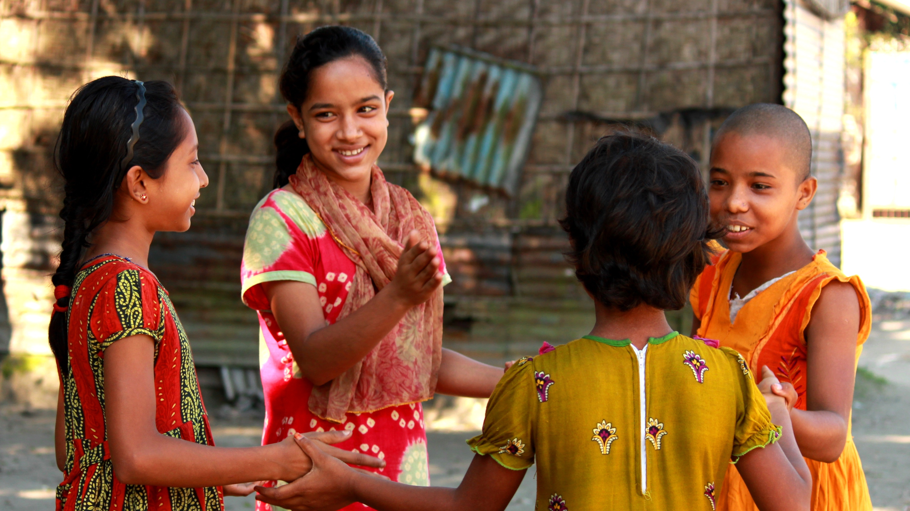
Findings & Interpretation
Notes:
We visualize our data using the Matplotlib package. Here are a few of our findings regarding the surgeries involving children-

Slide 11
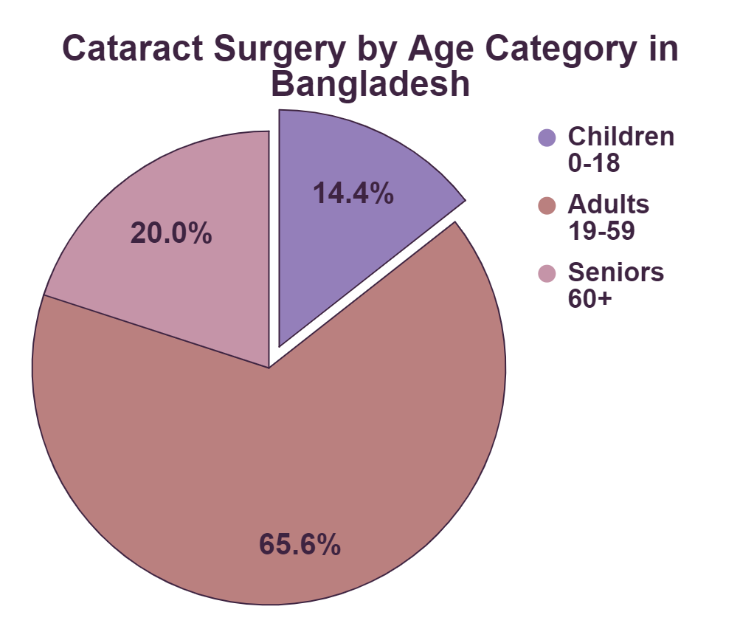
Cataract surgery by age
Notes:
This graph illustrates percentage of cataract surgery patients in each age category. The composition of this plot includes Children ages 0 to 18 at 14.4%, adults ages 19 to 59 at 65.6%, and seniors ages 60 or older at 20%.

Slide 12
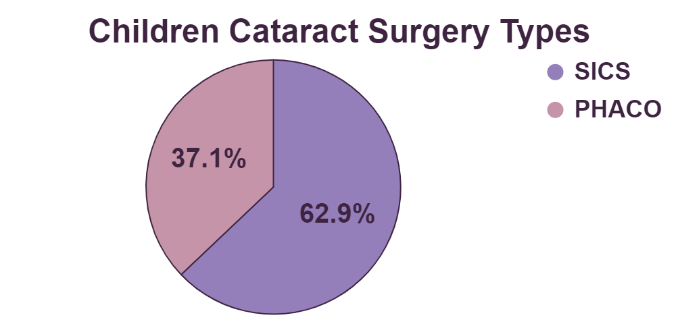
Most common surgery types
Notes:
This plot shows the percentages for the five most common surgery types in the Children age category. It shows that of the top five most common surgeries, SICS and PHACO, which are both types of cataract surgeries, makeup approximately 79% of surgeries.
To observe this in more detail, this plot showcases the percentages for the two types of cataract surgeries for children. Of the two different types, SICS is the more common surgery type at approximately 62.9%, PHACO makes up the other 37.9%.

Slide 13
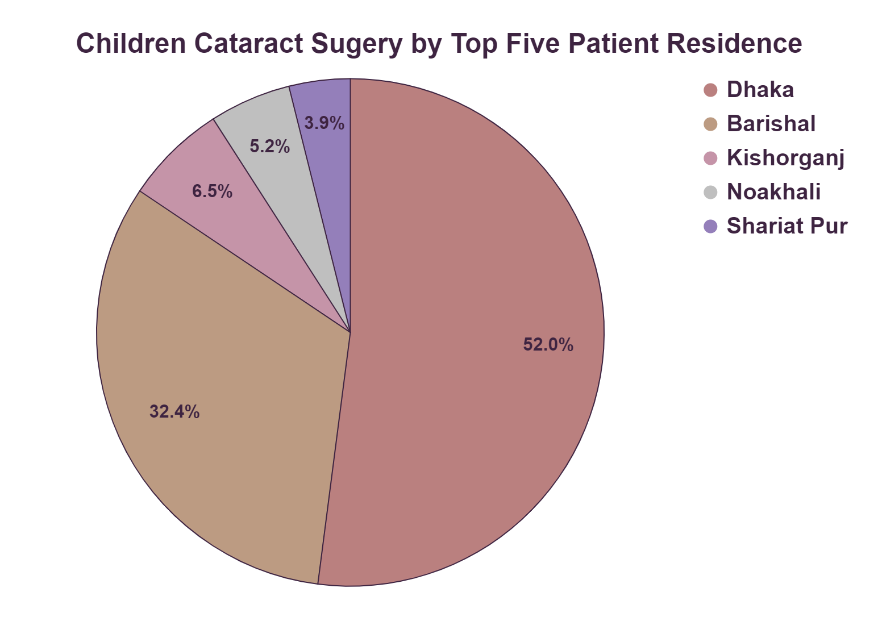
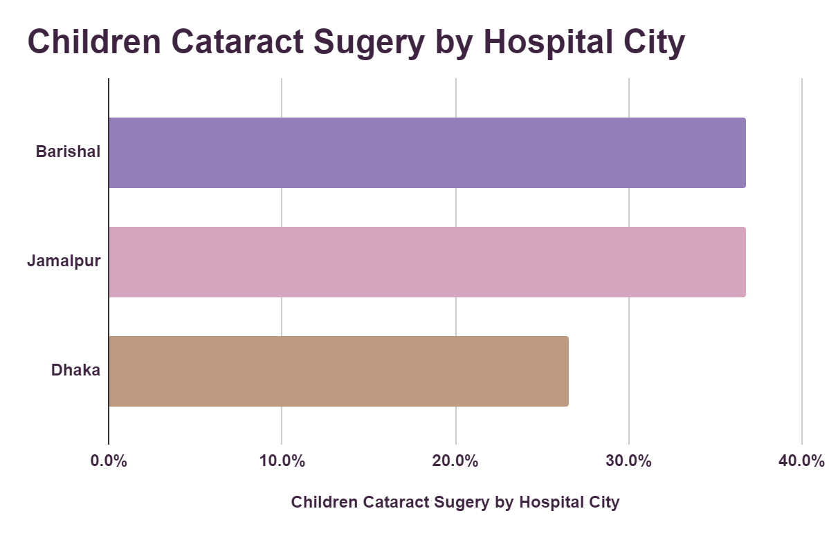
Patient residence and surgery city
Notes:
The percentages for the five most common Patient Residence cities in the Children age category. It shows that of the top five most common cities approximately 52.1% live in Dhaka, 32.4% live in Barisal, 6.5% live in Kishorganj, 5.2% live in Noakhali, and 3.9% live in Shariat Pur.
We were curious about the percent of cataract surgeries performed on children at each hospital city. Of these surgeries approximately 36.8% were done in Barishal, 36.8% were done in Jamalpur, and 26.5% were done in Dhaka.
According to the visualization, there is a shortage and infrastructure issue in treating children. Even though Dhaka has the most patients, they are unable to perform the most surgeries.

Slide 14
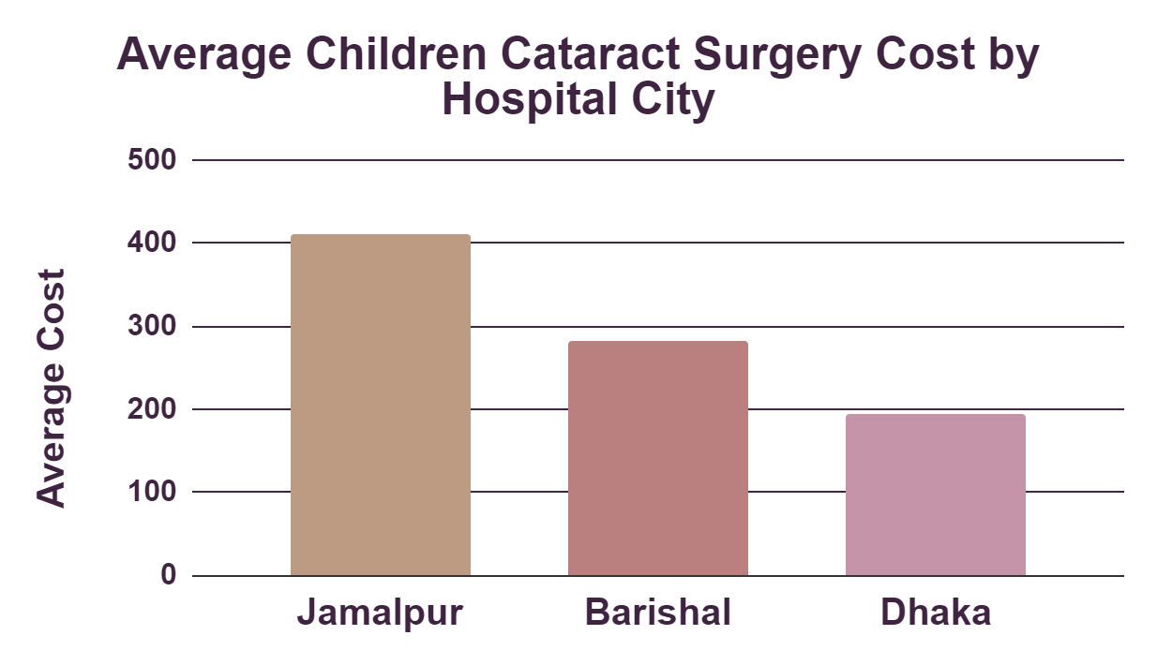
Cost of the cataract surgeries
Notes:
The average cataract surgery cost by hospital city for the Children age category. Jamalpur is the most expensive on average at 410.86 USD, Barishal is next at 281.65 USD, and Dhaka is the least expensive at 195 USD.

Slide 15

recommendation
Notes:
As mentioned, there are about 40,000 blind children in Bangladesh- many due to untreated cataracts. Research papers suggest that 69% of them are blind from avoidable causes. They advise that primary health care and primary eye care need to be strengthened; more tertiary pediatric eye care centers need to be developed, and a public health education strategy put in place. Because restoring sight to the 10k cataract blind children and preventing blindness in the 50 million children at risk remain a major challenge in Bangladesh, we would like to offer the following plan to the Board of Directors.
How does this relate to our analysis?

Slide 16
Overall focus
Reduce the number of children with cataracts
Three main actions:
Provide check-ups
Educate families
Partner with non-profits
Notes:
Our plan focuses on preventive measures to reduce the number of children admitted to the hospital for cataracts. In the long-run, this will be the most important goal. Our three main actions are to provide check-ups, educate the families in Bangladesh, and partner with relevant non-profits.

Slide 17
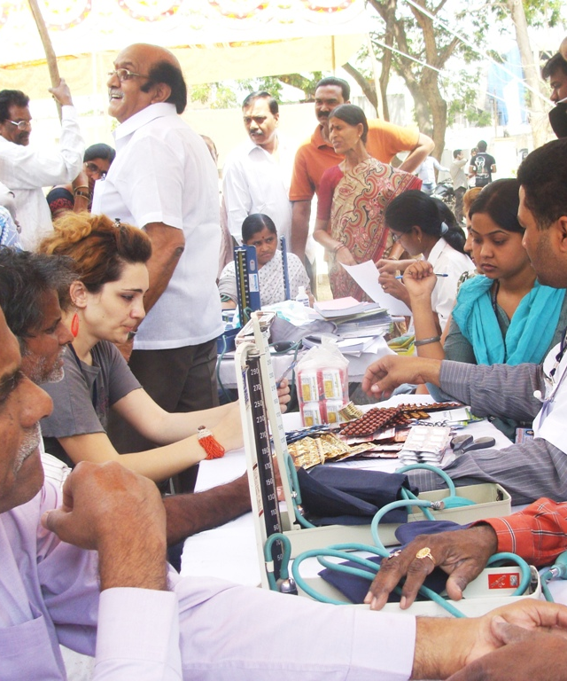
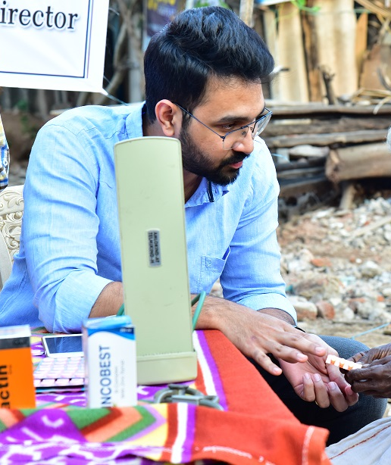
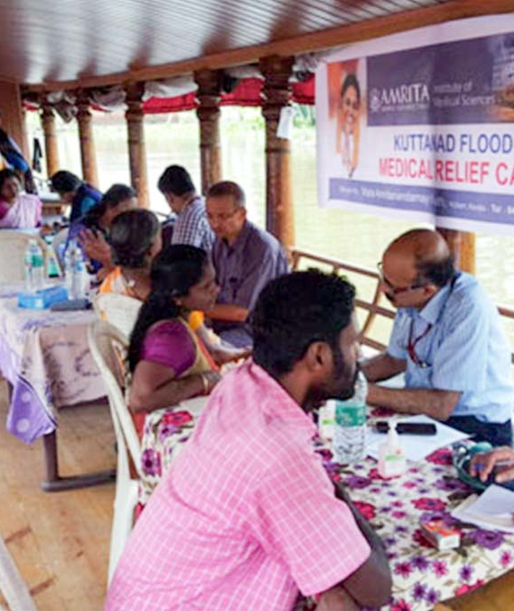
Medical camps
Install camps near the 20 locations of the hospital
Travel every weekends to these regions
Remain in that location for a month
Notes:
We will shift the focus of our volunteer force to install camps in Dhaka. According our analysis, Dhaka is where the children with cataracts reside, but also where it receives the least number of cases out of the three populated cities. The point of the camps is to use it as a tool to educate lower-income families around the areas where our hospitals operate. Since many people don’t work on weekends, the volunteers will travel every weekend to these regions and remain there for a month. We will hand out pamphlets notifying our weekend sessions and emphasize on the urgency of the situation.

Slide 18
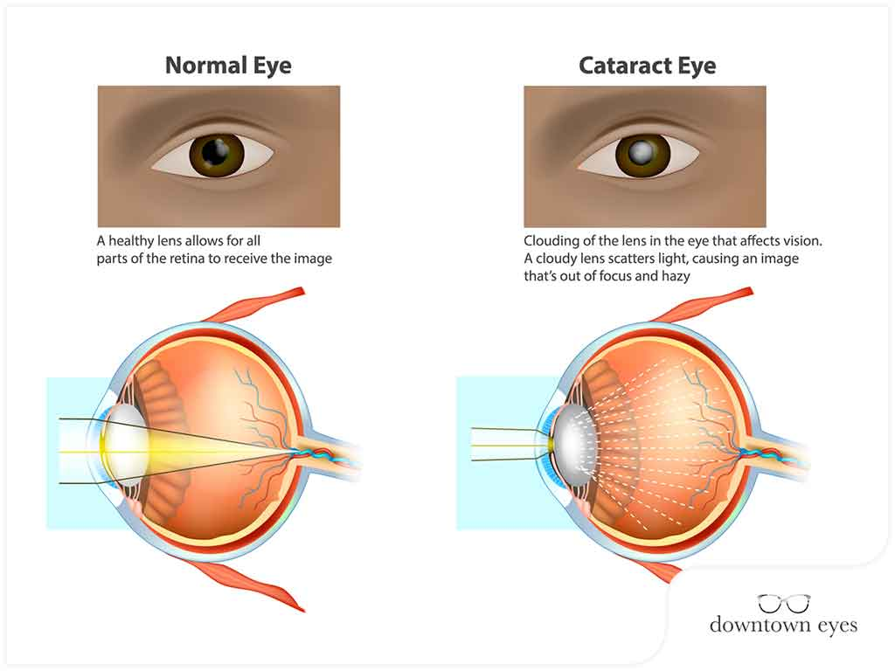
1st weekend: Introduction
Explain cataracts and the phenomenon
Counsel parents to look for cataracts
Links to cataracts: diet, genes, etc.
Notes:
In the first weekend session, we will explain what cataracts are and the phenomenon for children with cataracts in Bangladesh. We will speak to them about the link of cataracts to the Bangladeshi diet and their genetic make-up. We will counsel parents on how to look for the early signs of cataracts and how preventable this disease is.

Slide 19
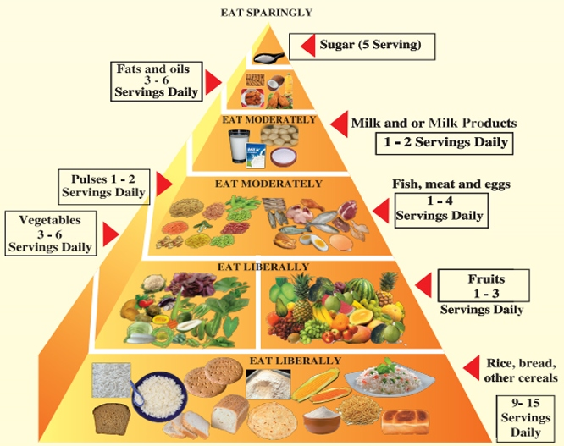
2nd weekend: diet
Awareness about Bangladeshi diet
Research healthy vendors
Food recommendation based on the dietary guidelines of Bangladesh
Notes:
In the second weekend, our volunteers will use the information from dieticians to educate families on the Bangladeshi diet and why that needs to change. Food in Bangladesh are unhealthy and hard to digest. We need to research vendors in the area who sell food with anti-oxidants and recommend families to lower the intake of beef, rice, and heavy meals at the same price level. If they still cannot afford the food, we will give them food pantry options that we have partnered with. They can sponsor meals for families and schools.

Slide 20
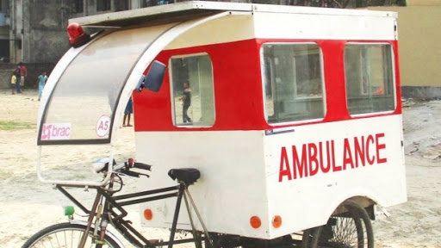
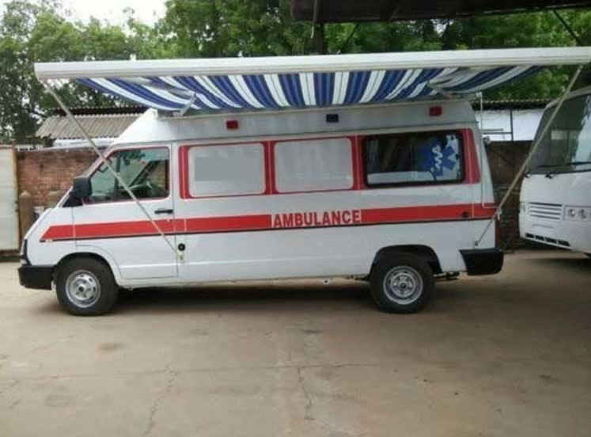
3RD weekend: FREE-CHECKUPS
Solar-powered ambulance in Bangladesh
Provide free check-ups
Utilize mobile ambulances for immediate treatments
Offer resources from the Ispahani hospitals
Notes:
In the third weekend, we will provide free check-ups for families that attend this session. For children who show signs of cataracts or have cataracts, we can utilize mobile ambulances that other non-profits offer to treat them right in the village. We will offer them resources to our hospital nearby if they cannot make it that day.

Slide 21
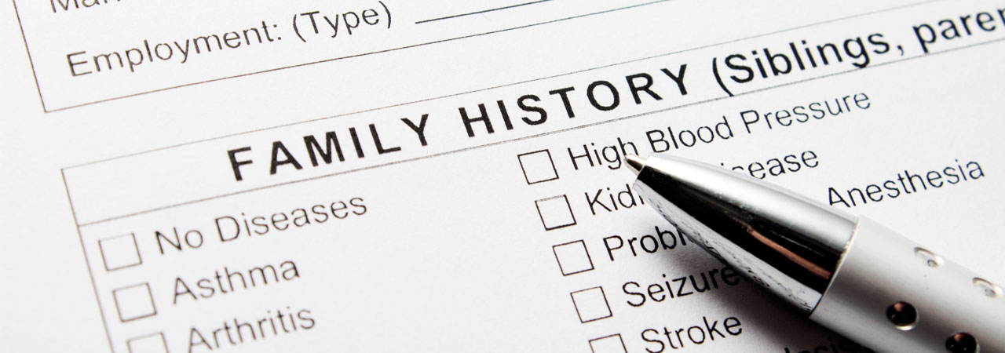
4th weekend: medical record collection
Collect family medical record
Study the pattern by digitizing
Prevent the disease at birth
Notes:
In the fourth weekend, we will garner the trust of the families enough to ask them to start collecting their family medical record. We need to see the pattern overtime and study the genetic effects of cataracts in the population. Most importantly, if families have knowledge that certain diseases have been occurring in the family and record that in their medical history, it is easier to prevent the disease at birth.
This will be our monthly plan in each city that is in the vicinity of our hospital locations. We hope to reduce blindness in 70% of the cases in Bangladeshi children.

